Slide 1
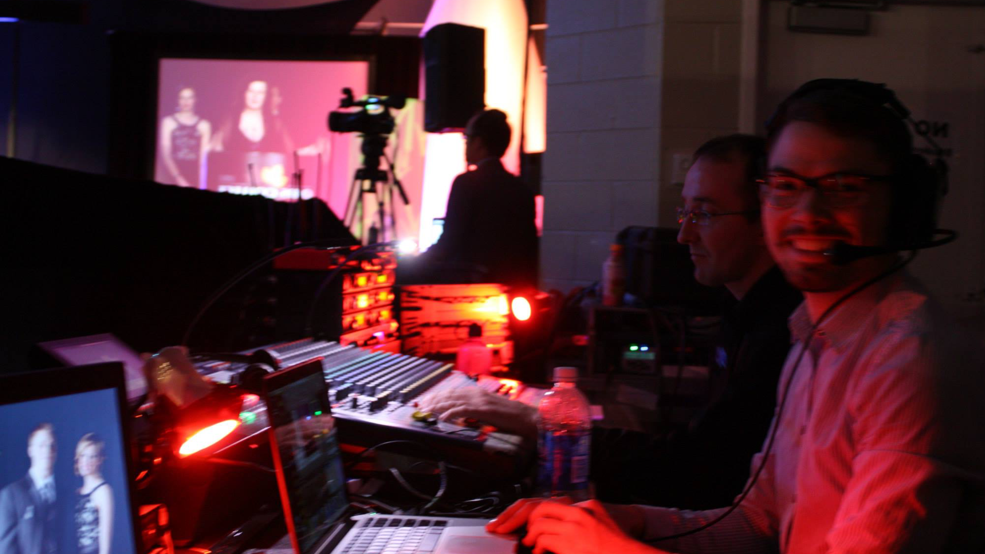

Freelance AV Technician
Michael
Lewis
Email Now
Freelance AV Technician
Michael Lewis

Slide 2
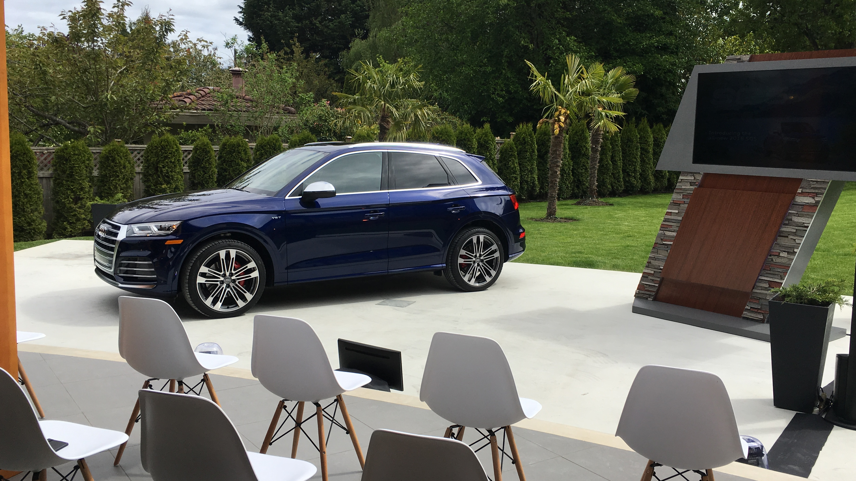
Freelance AV Technician
Michael
Lewis
Email Now
About this Cover Letter
I made this presentation as my portfolio and highlights, as well to showcase my graphic design skill and eye for branding. Feel free to use the buttons if viewing through Keynote or Powerpoint, or just scroll forward when looking at the PDF.
-Click “About the Photo” for a client / event showcase.
-At any time you can click “Email Now” to get in touch!
Thanks and enjoy,
Michael
ABOUT THE PHOTO
NEXT

Slide 3
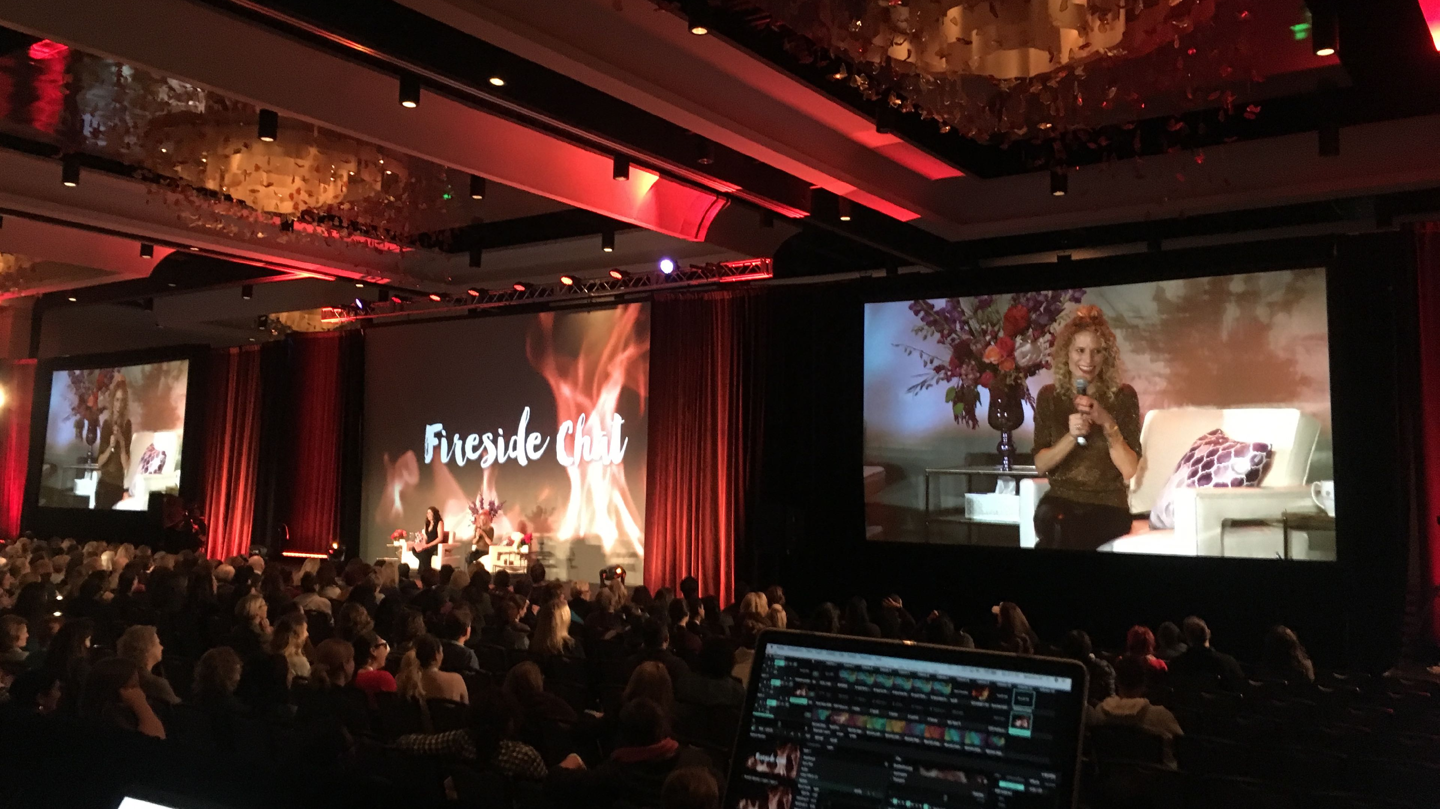
Freelance AV Technician
Michael
Lewis
Email Now
Why London, Why UK?
I Moved to London from Canada in June 2018 with my partner. Both of us are aiming to advance our careers by approaching opportunities that simply aren’t available in Canada at this large of a scale.
I intend on growing my portfolio, skillset and client base through good customer service, hard work and recently completed trainings.
I am centrally based in London, properly insured and ready for any corporate or entertainment and music roles.
Current Client UK Client List -
Corporate Events (Swindon), C3 Productions (Brighton), Metro Broadcast (London), Digital Concrete (London), Hackney Arts Centre, Kings Place (London)
ABOUT THE PHOTO
NEXT

Slide 4
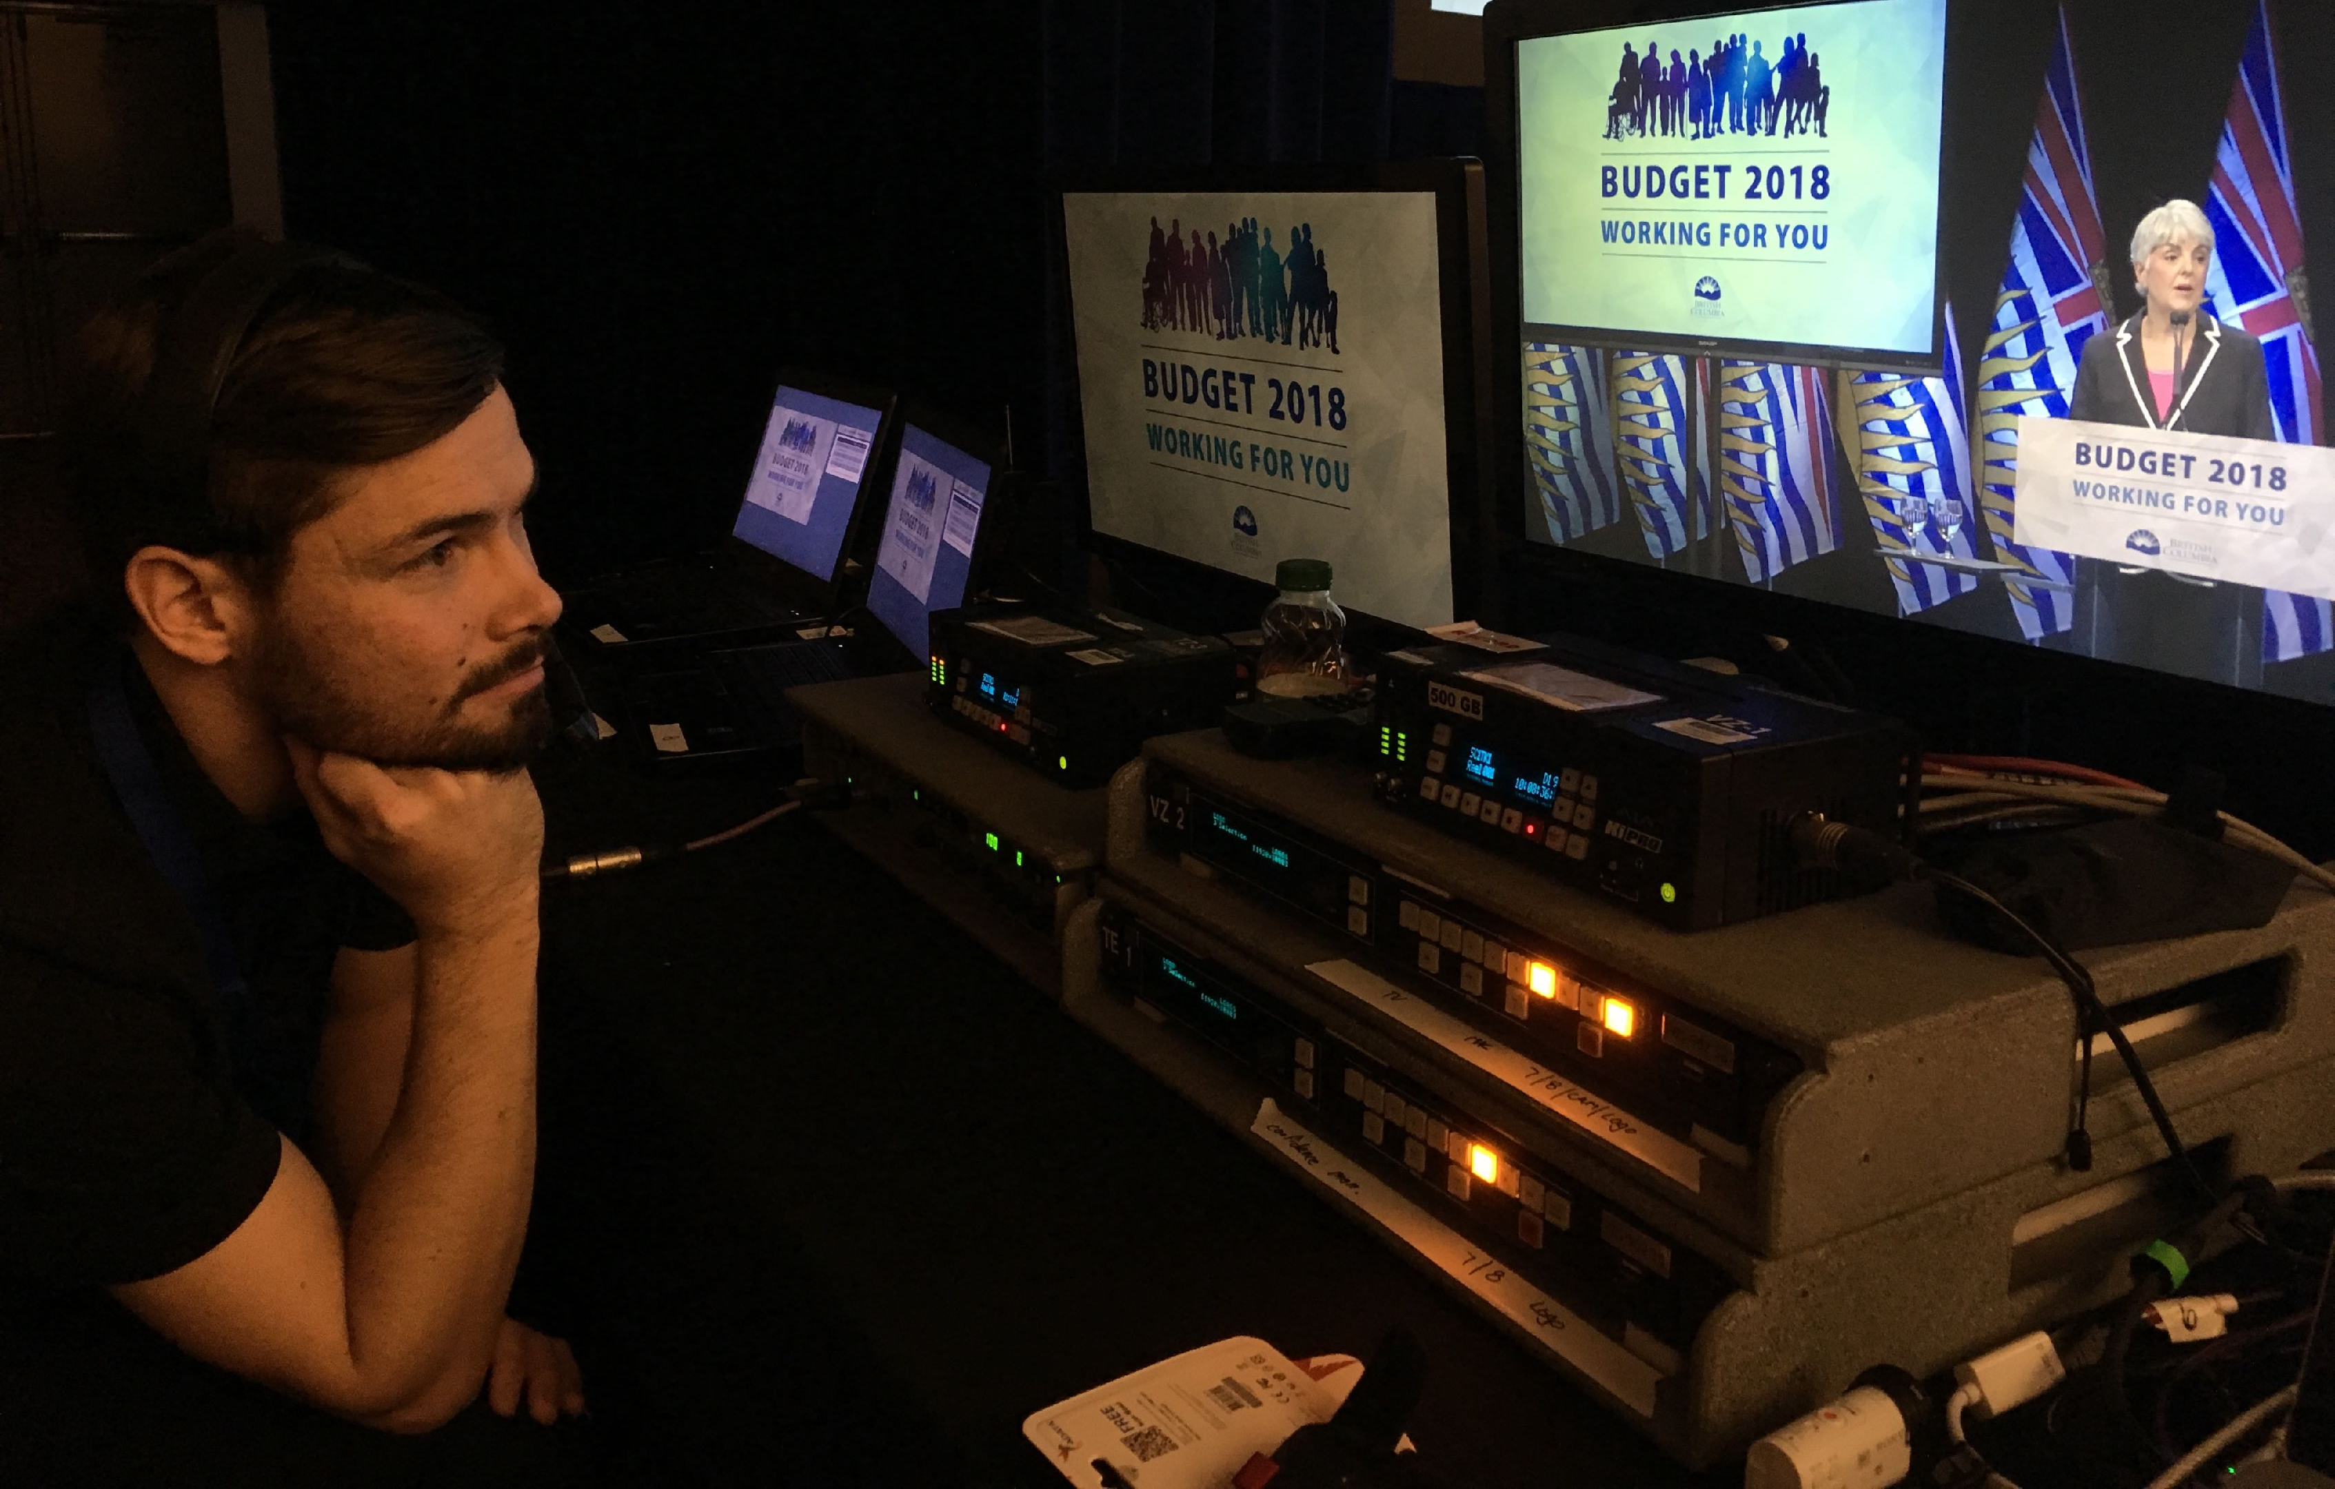





Freelance AV Technician
Michael
Lewis
Email Now
Multi-Discipline, Always Learning
Jack-of-all-trades, but master of none? I disagree
CLICK A DISCIPLINE
NEXT
Audio
Video
Digital
Display
Lighting

Slide 5
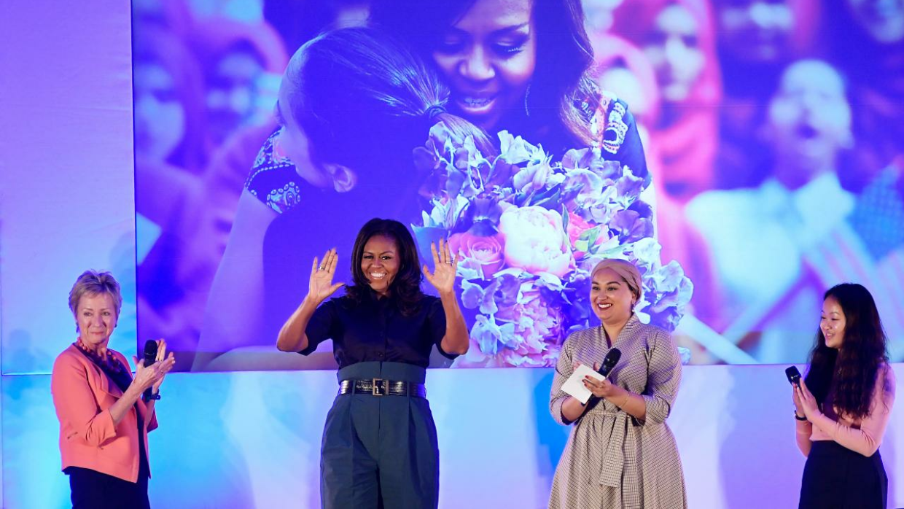




Freelance AV Technician
Michael
Lewis
Email Now
How to get in touch
07383669803
michael@mvav.ca
Michael Lewis
NW1 London
EXIT
ABOUT THE PHOTO

Slide 6
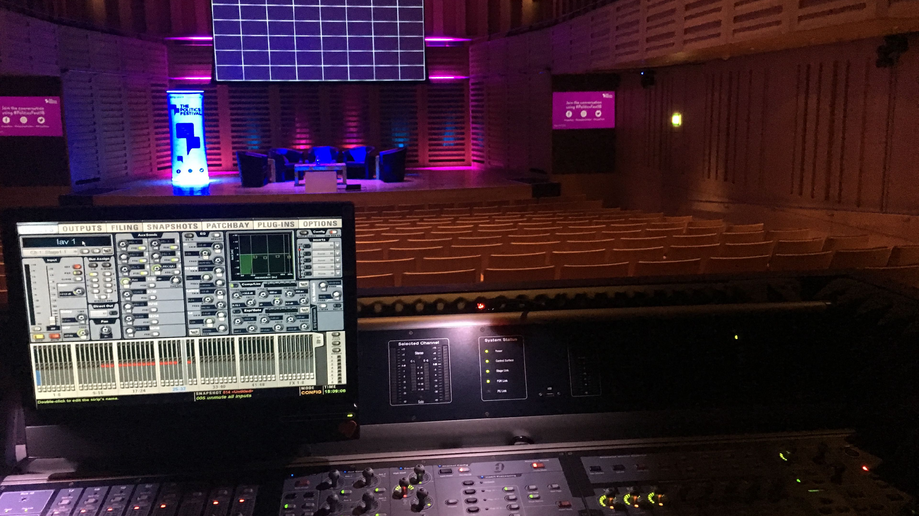
Freelance AV Technician
Michael
Lewis
Email Now
Audio
Audio is where I got my start in this industry. I went to school to become an electrician and ended up shadowing at the university venue as an audio engineer.
I’ve spent 3 years as resident tech at a 500-cap music venue, doing FOH, monitors and lighting. Over the last 9 years I’ve done countless high profile corporate events, on everything from a Mackie 1402 to a D-Show. I am used to the pressure of being live-to-air for audio, having done many government press briefings. I have certifications from major vendors for wireless coordination, networking (Dante level 2), and console operation
I am comfortable on-
Yamaha CL and QL (and LS9), Soundcraft Vi and Si series, Avid Venue series, Allen and Heath, any analog hardware, Shure Wireless Workbench, Smaart, Reaper and more.
I’d like to push myself more for systems engineering, and plan on taking line array and predictions courses from L-Acoustics and d&b. I would also like to get in more time with DiGiCo platforms.
BACK

Slide 7
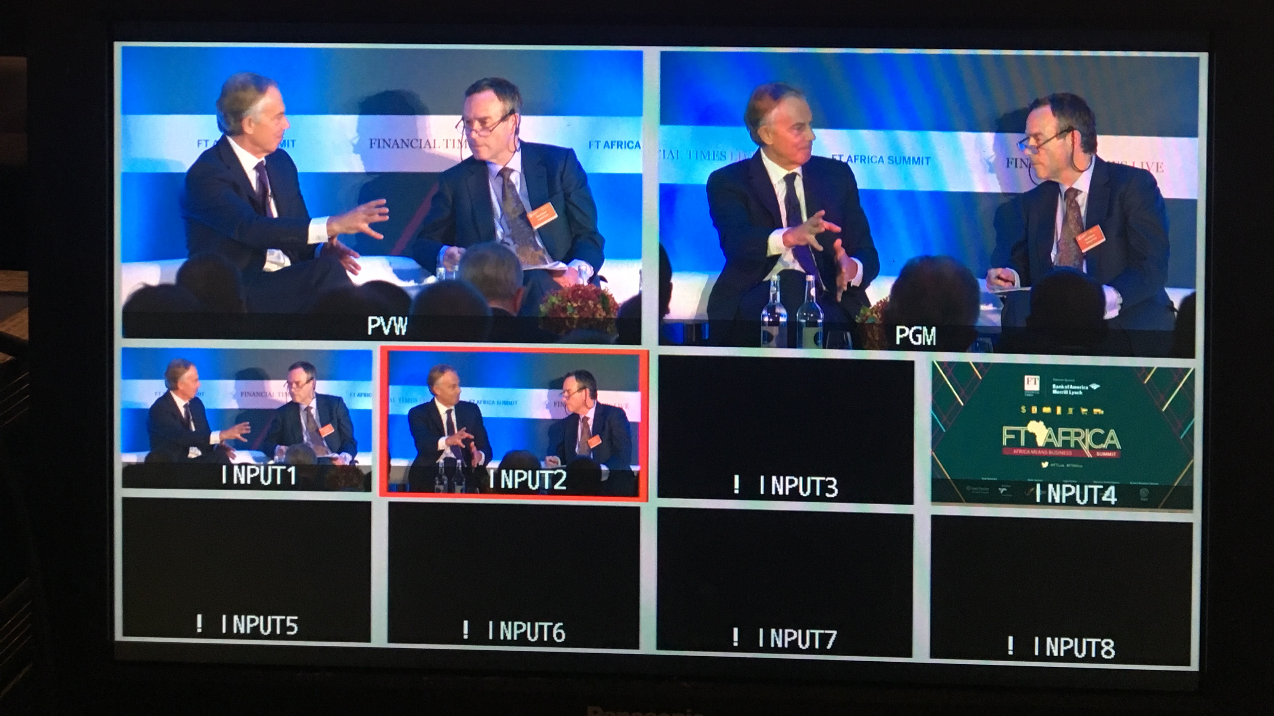
Freelance AV Technician
Michael
Lewis
Email Now
Video
Having spent many years as Graphics, VT, and Vision mixing, I come fully prepared for almost any video position. Having also spent time as a camera-operator, I can work closely to make sure the footage produced will be exactly what the end client was looking for.
I am confident with-
Playout Software - Qlab, Playback Pro, CasparCG (still learning), PowerPoint, Keynote, Millumin, Resolume Arena
Switching Platforms - Barco, Analog Way, Christie, Blackmagic, Roland, Panasonic and Data Video.
I travel with my own Stream Deck and MacBook Pro.
I would like to learn more with -
D3, E2, Grass Valley, Broadcast-focused playout, and more about camera shading for broadcast.
BACK

Slide 8
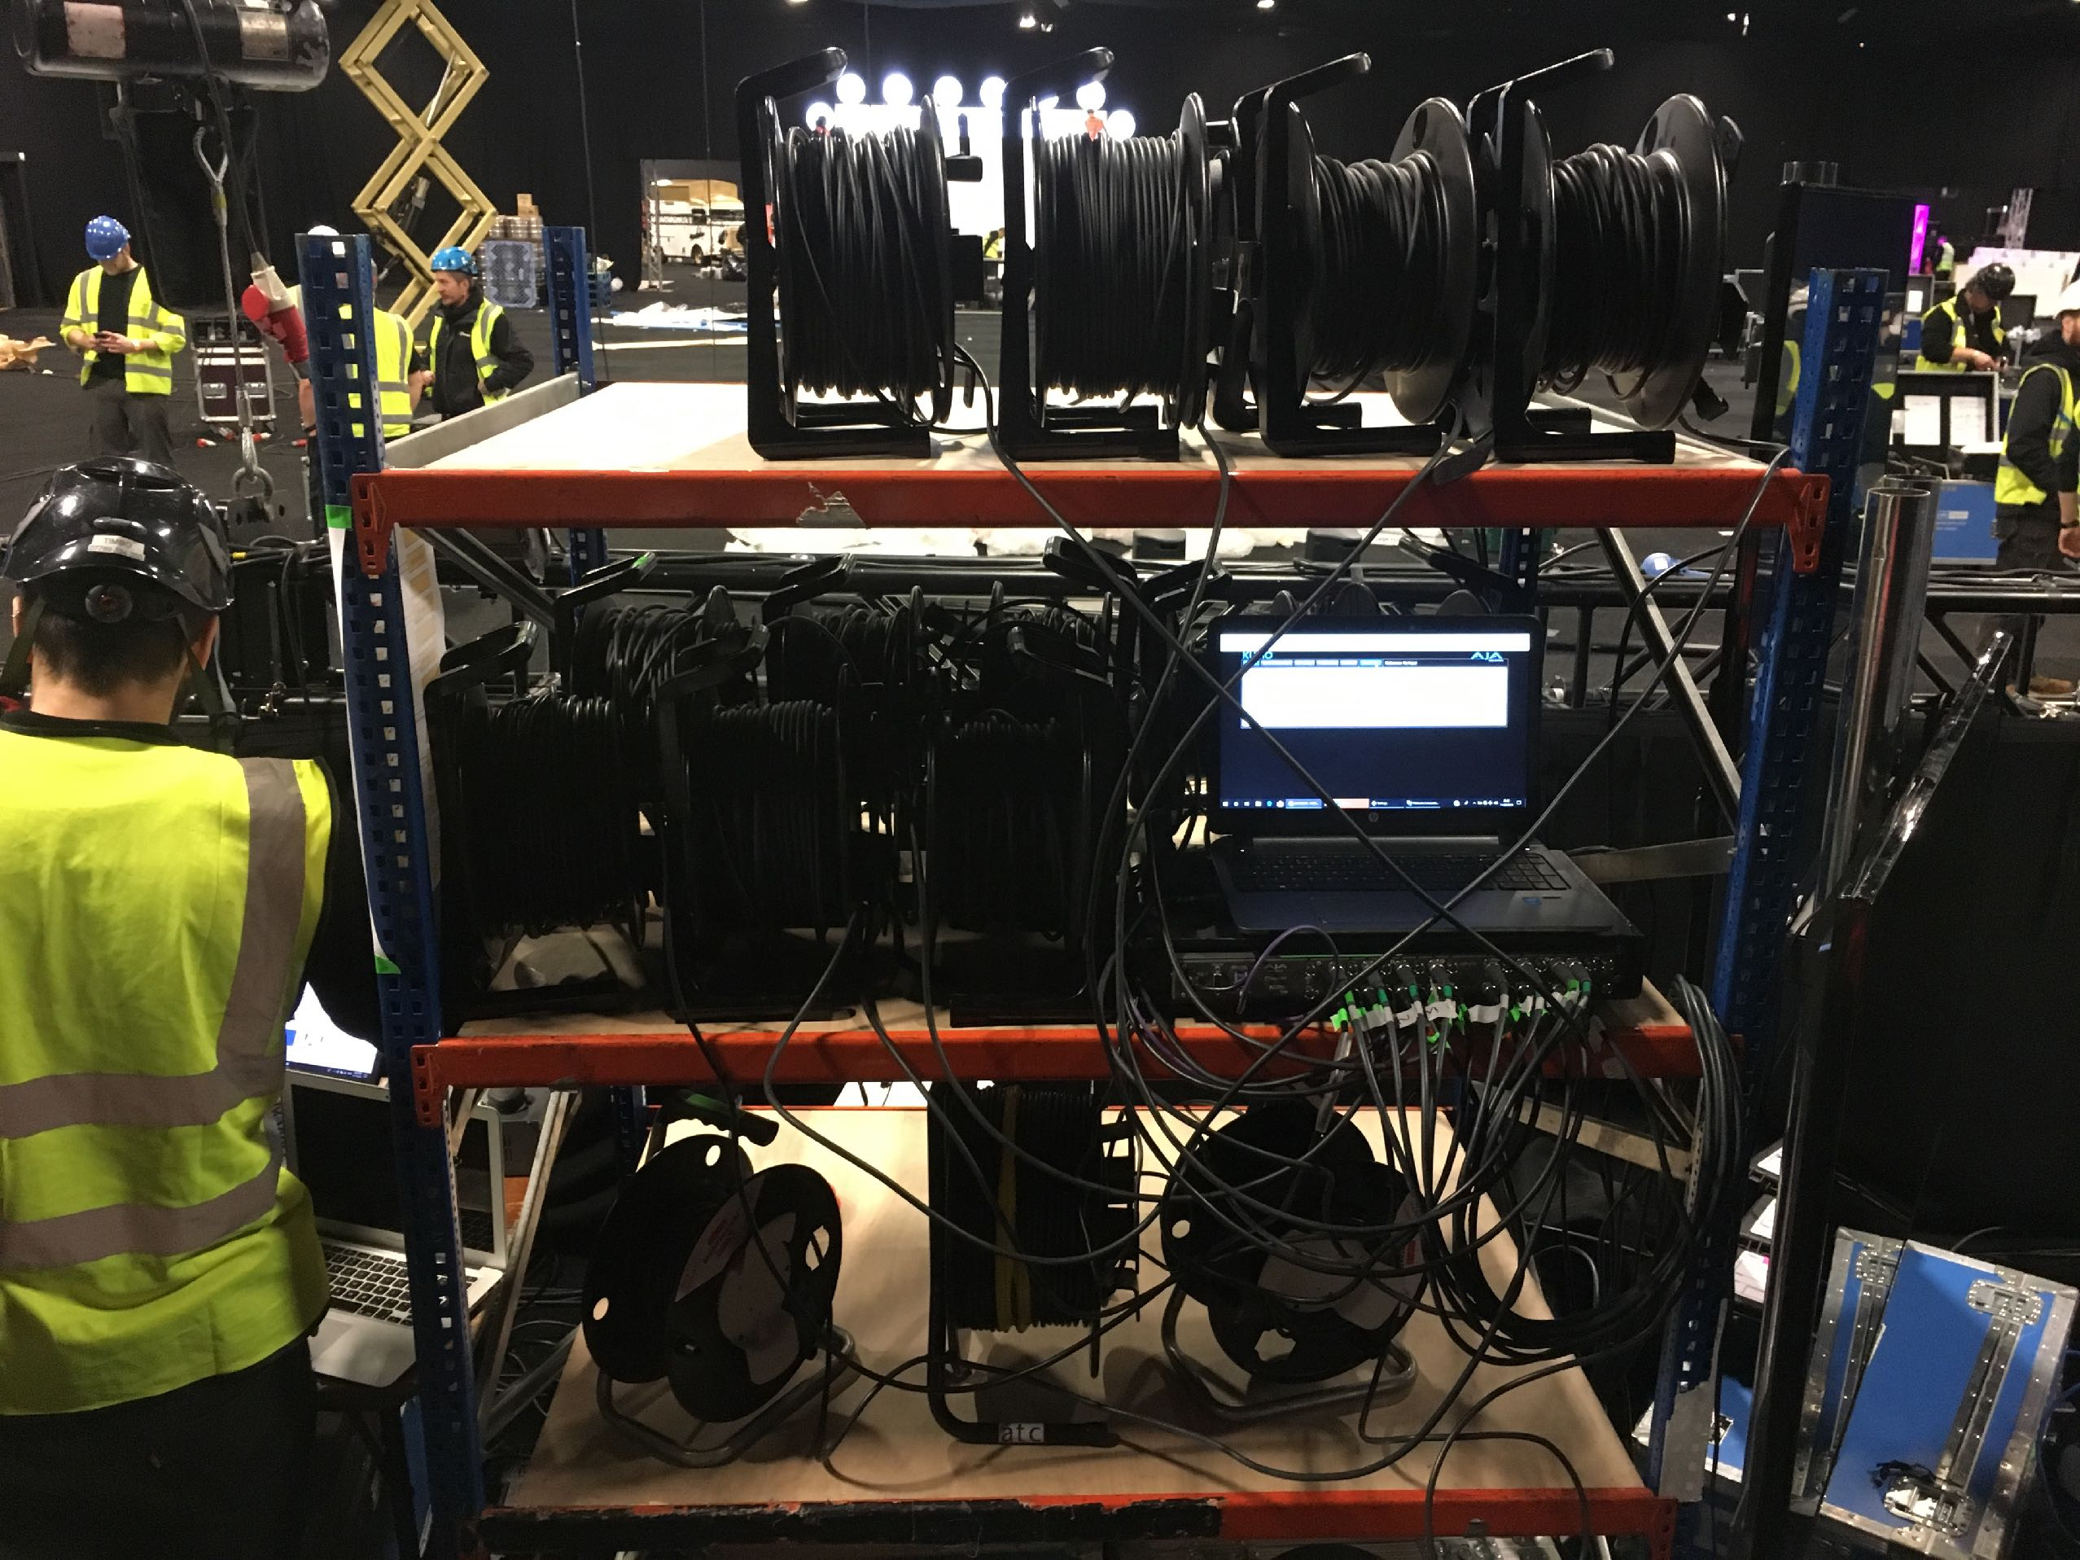
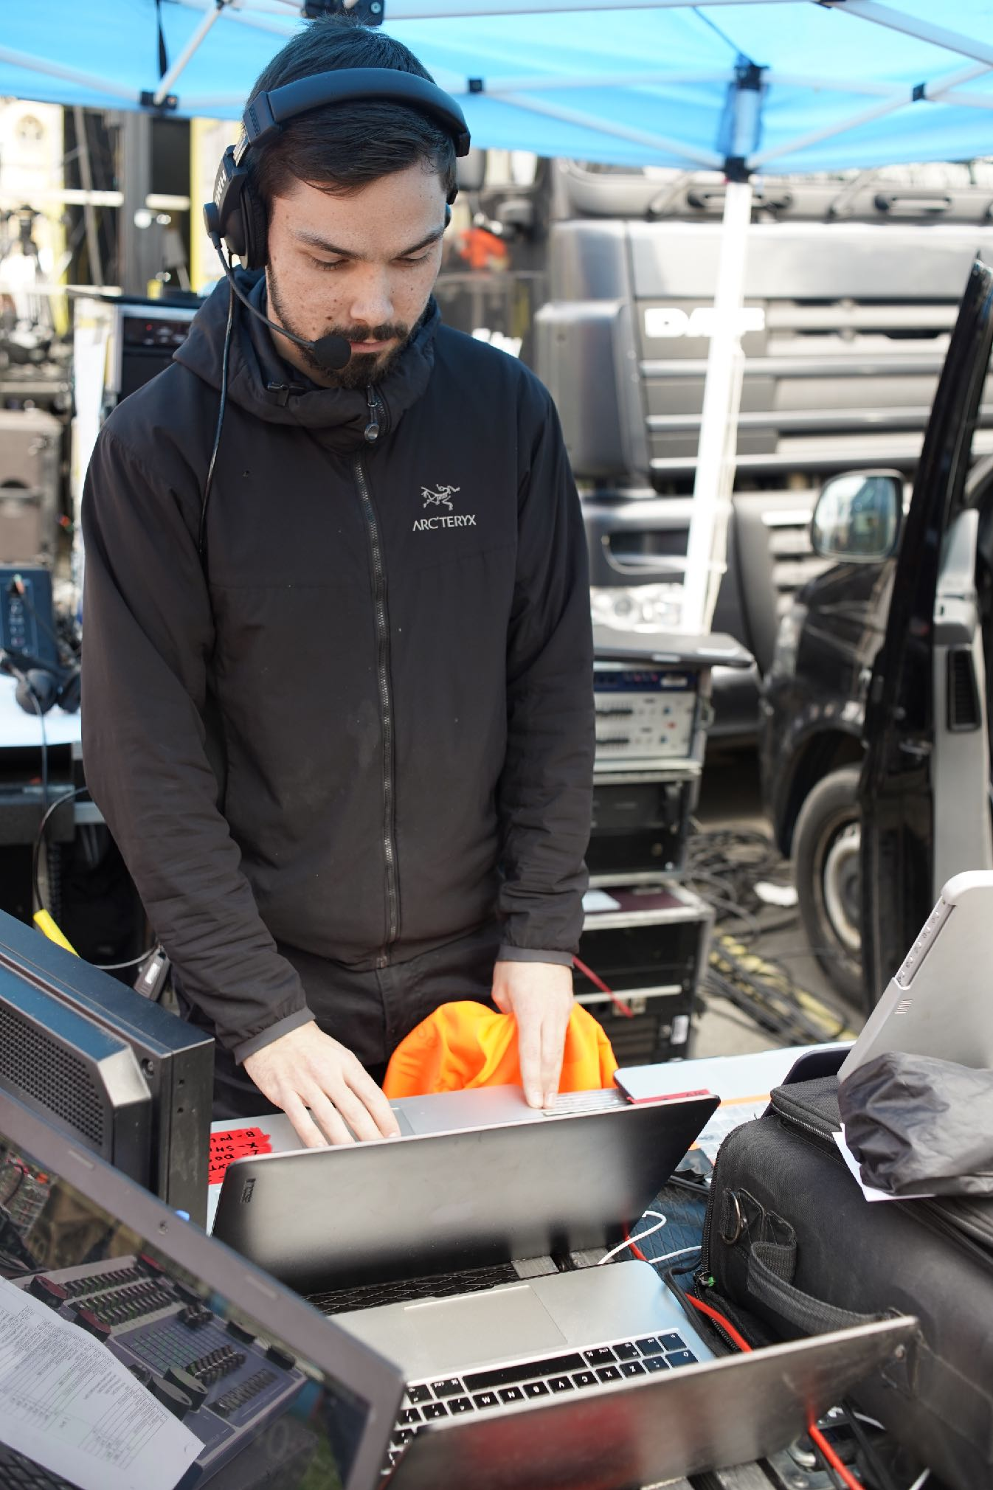
Freelance AV Technician
Michael
Lewis
Email Now
Digital
As the standards keep changing, I continue to keep learning and adapting. An interesting game of cat and mouse, we need to adapt to cutting edge demands while keeping our signal as fail-safe as the tried-and-true older methods. 4k,8k,60hz, HDR, how can we jam it all down one line safely?
With everything digitised now, it’s become easier to think of a show based in Gbp/s and choosing the medium. Pictured behind is 24 spools of SDI carrying 3G 1080 to and from various locations. Fibre would have been nice that day, considering most went to sets of double stacked projectors.
My networking skills are up to par, having taken Dante Level 2, Shure’s Network for AV Professionals and Microsoft’s Online IT courses.
BACK

Slide 9
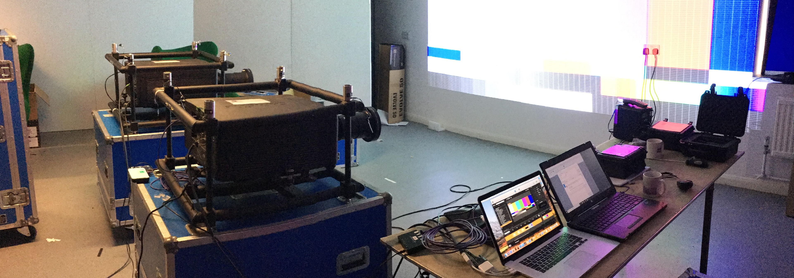
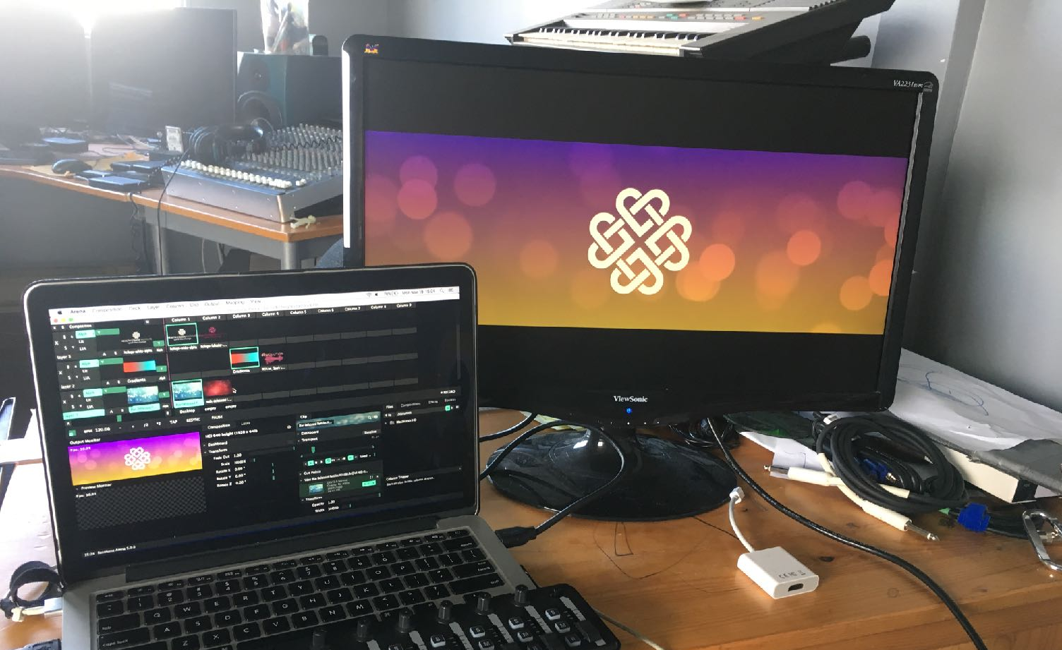
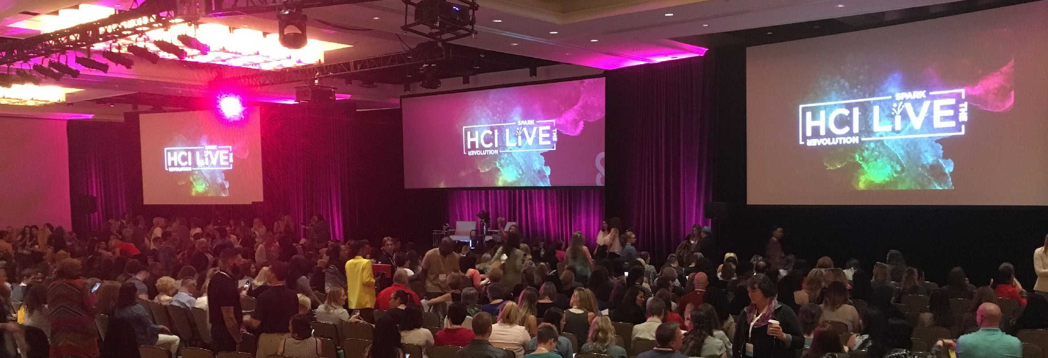
Freelance AV Technician
Michael
Lewis
Email Now
Displays
I have plenty of hands-on time with projection, edge blending, data doubling, surface mapping and warping. I have planned and deployed unique aspect ratio screens, multiple-surface-immersive-spaces and plenty of traditional 16:9. I have worked with content creators and brand marketing directors to shape content that will work well on unique screens, whether it’s a textured and moving background, or animated sting moments.
I am confident with-
Millumin, Resolume Arena, Christie Twist
I haven’t worked with much LED and would really like to push myself in that direction. I know that upstream on the data pipeline, content needs to be manipulated well in order to get the best look on LED, and I want to become the expert!
BACK

Slide 10
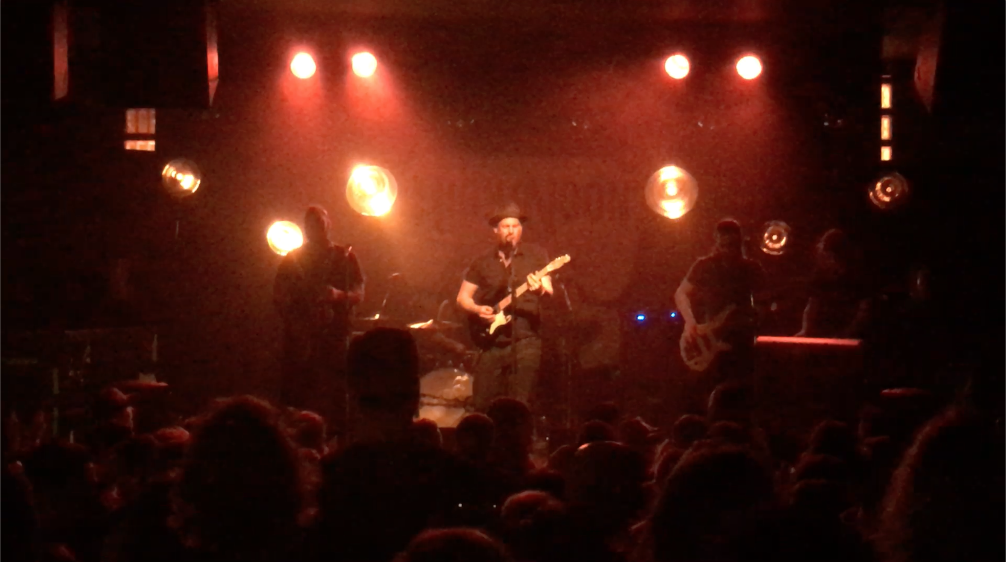
Freelance AV Technician
Michael
Lewis
Email Now
BACK
Lighting
-I understand and value the importance lighting has on an event. I know what is needed for good 3 point lighting, and how hard it is to get “soft lighting” out of a source 4 from a truss line 30m away. I also know the impact a good dramatic light scene can have on an event and how to draw the eye to what I want it to focus on.
-That being said, I’m not a very strong programmer. I have vision and can effectively communicate what I need for lighting up a shot for cameras and screens, but I am not strong with bringing that vision to life.
-I am however competent with addressing fixtures, network deployment, and safe rigging practices, so I’d make a great L2.
-Seen in this photo are some fixtures I made and designed from large bowls and edison lamps for a friends band.

Slide 11
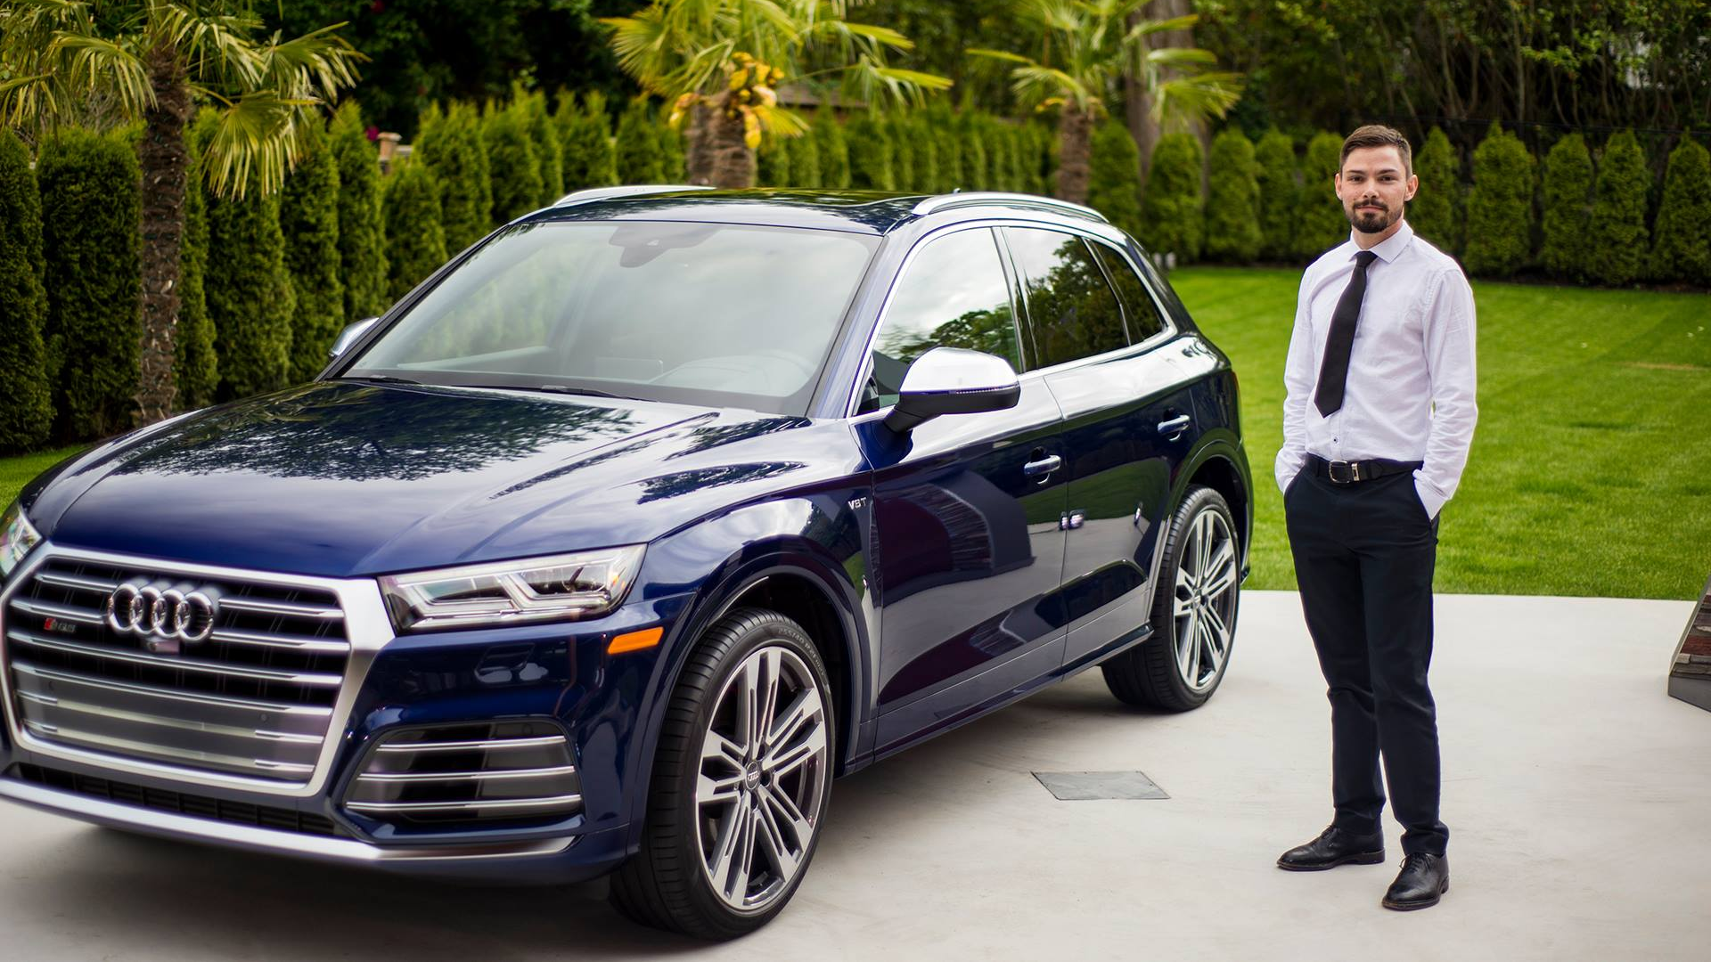
Freelance AV Technician
Michael
Lewis
Email Now
Audi Car Reveal - Canada 2017
I was contacted by Gail and Rice from Detroit to provide a complete AV package for their Audi SQ5 promo event in Victoria Canada. They had a short presentation followed by a roadtrip along Canada’s scenic pacific coastline. I provided them (and operated) a sleek audio system, a lighting package for the car at night, and video signal and play out for their custom designed monitor stand. I don’t typically provide full package AV, but this was a great experience to provide and end-to-end service for an easy client. It helped me understand and respect all aspects of the business, including sales, branding and budgets.
MORE PHOTOS
BACK

Slide 12
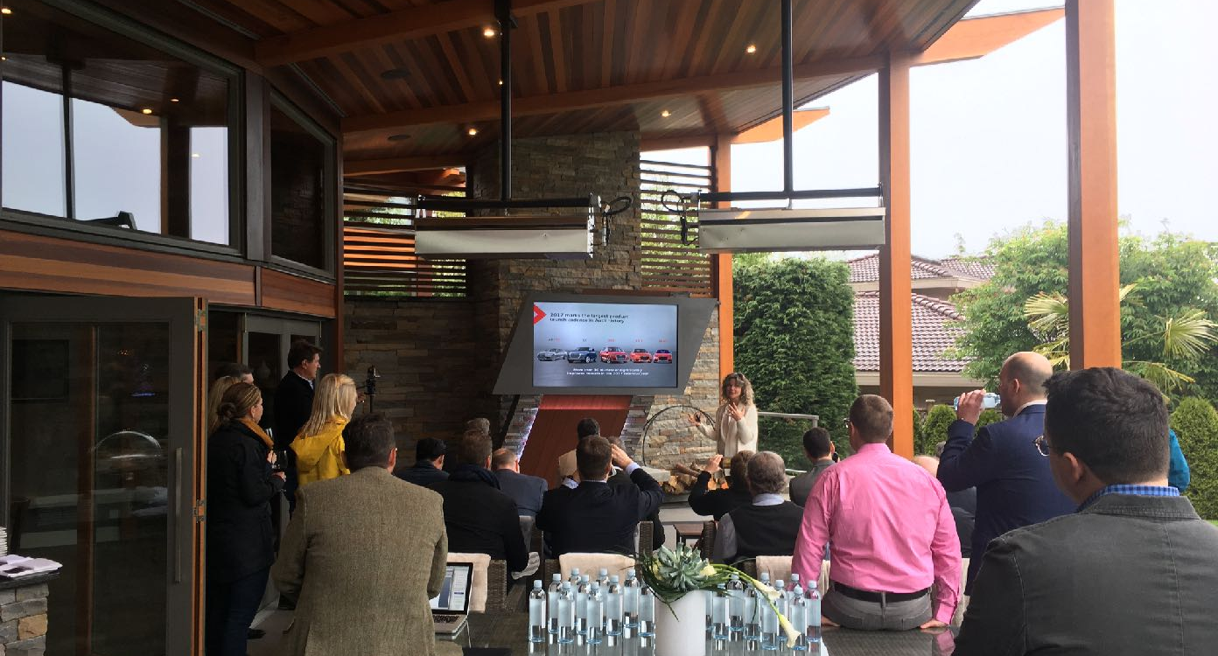
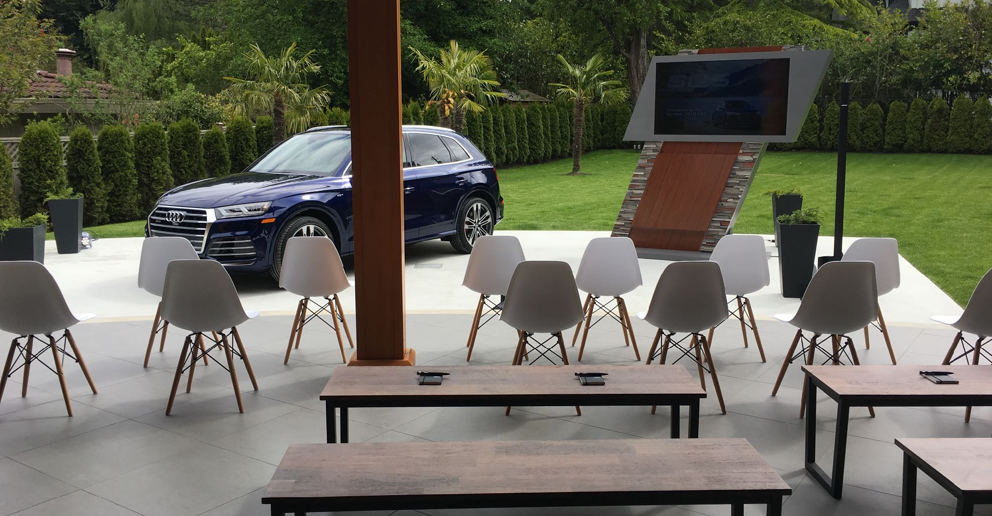
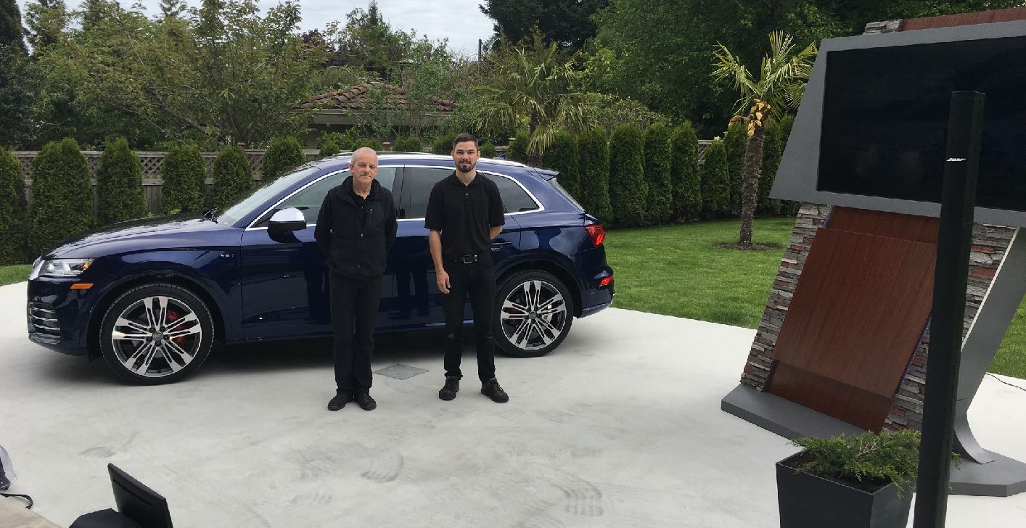
Freelance AV Technician
Michael
Lewis
Email Now
Audi Car Reveal - Canada 2017
BACK

Slide 13
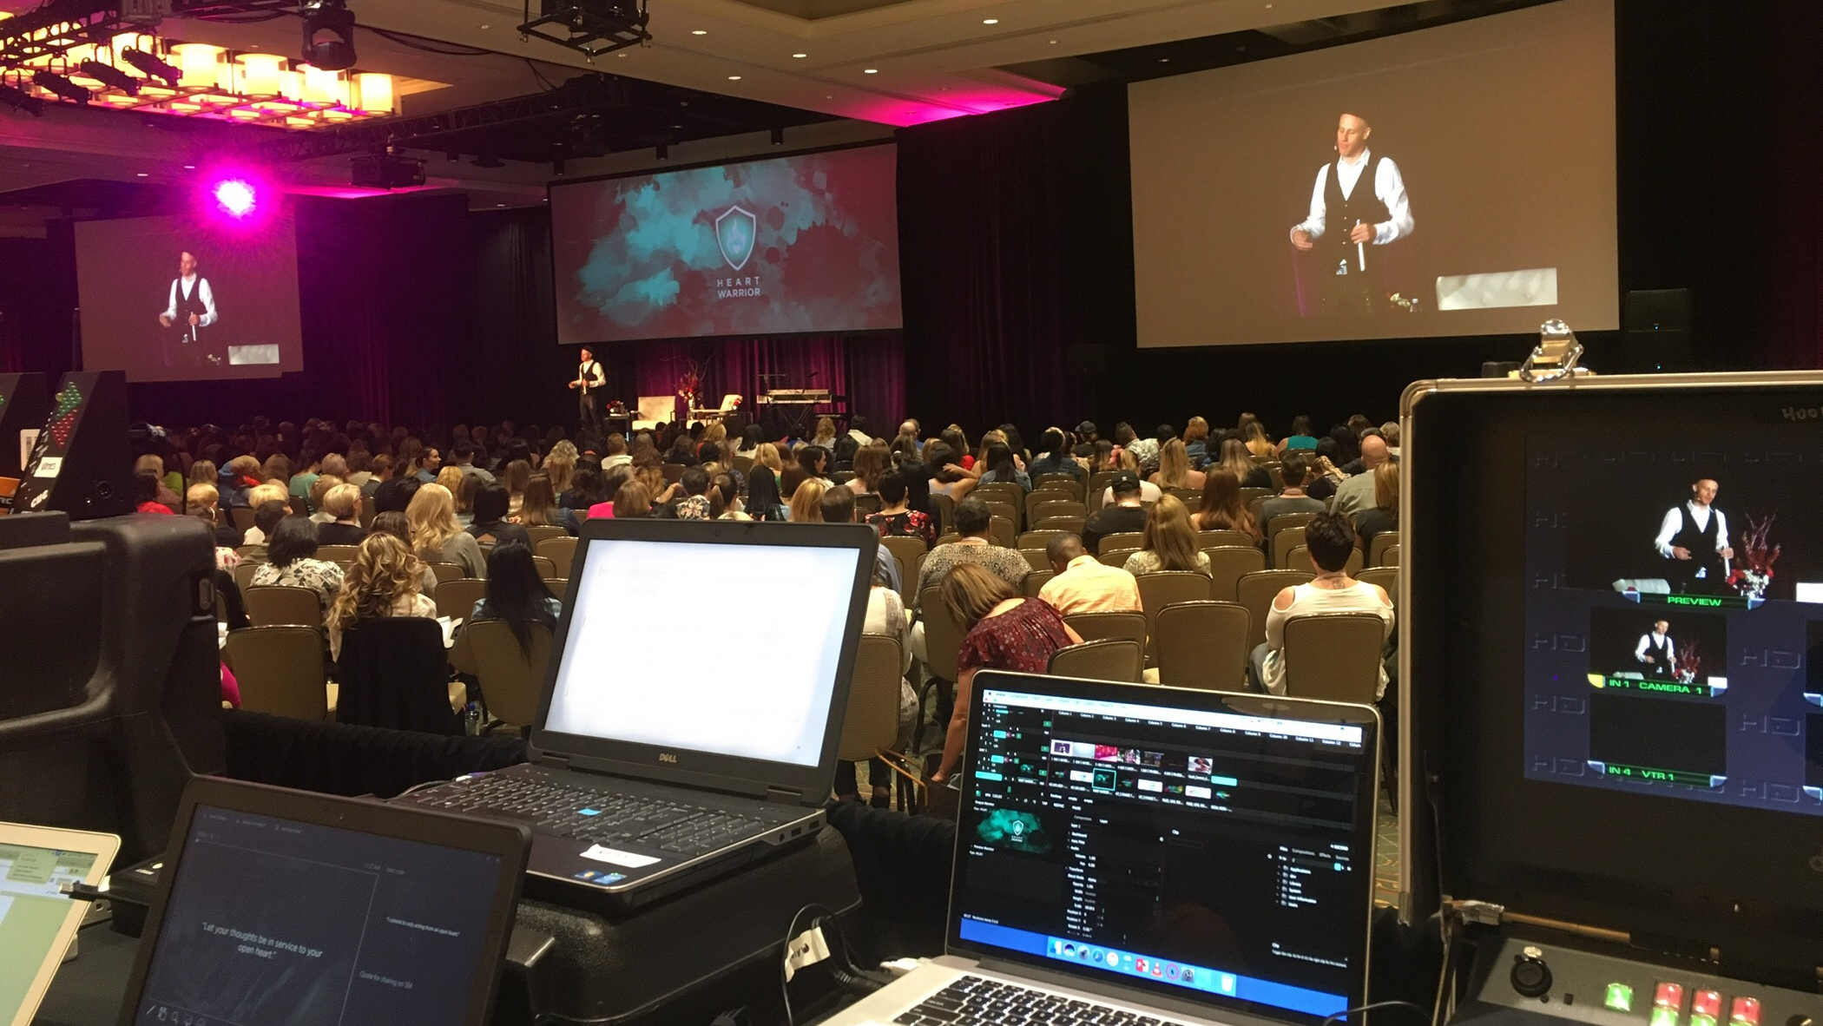
Freelance AV Technician
Michael
Lewis
Email Now
HCI Live - North America 2015 - Today
I am the head of video department for a mid-size travelling talk-show format event in North America. Occuring every few months, I am responsible for pre-plan, content creation, crew leading, operation, video streaming and delivery. It has an Oprah Winfrey feel, and is live-streamed to their clients at home. On show day, I take care of all VT, vision mixing and camera-calling. We get to have some fun in their evening sessions and dance galas where I can flex my VJ skills.
BACK

Slide 14
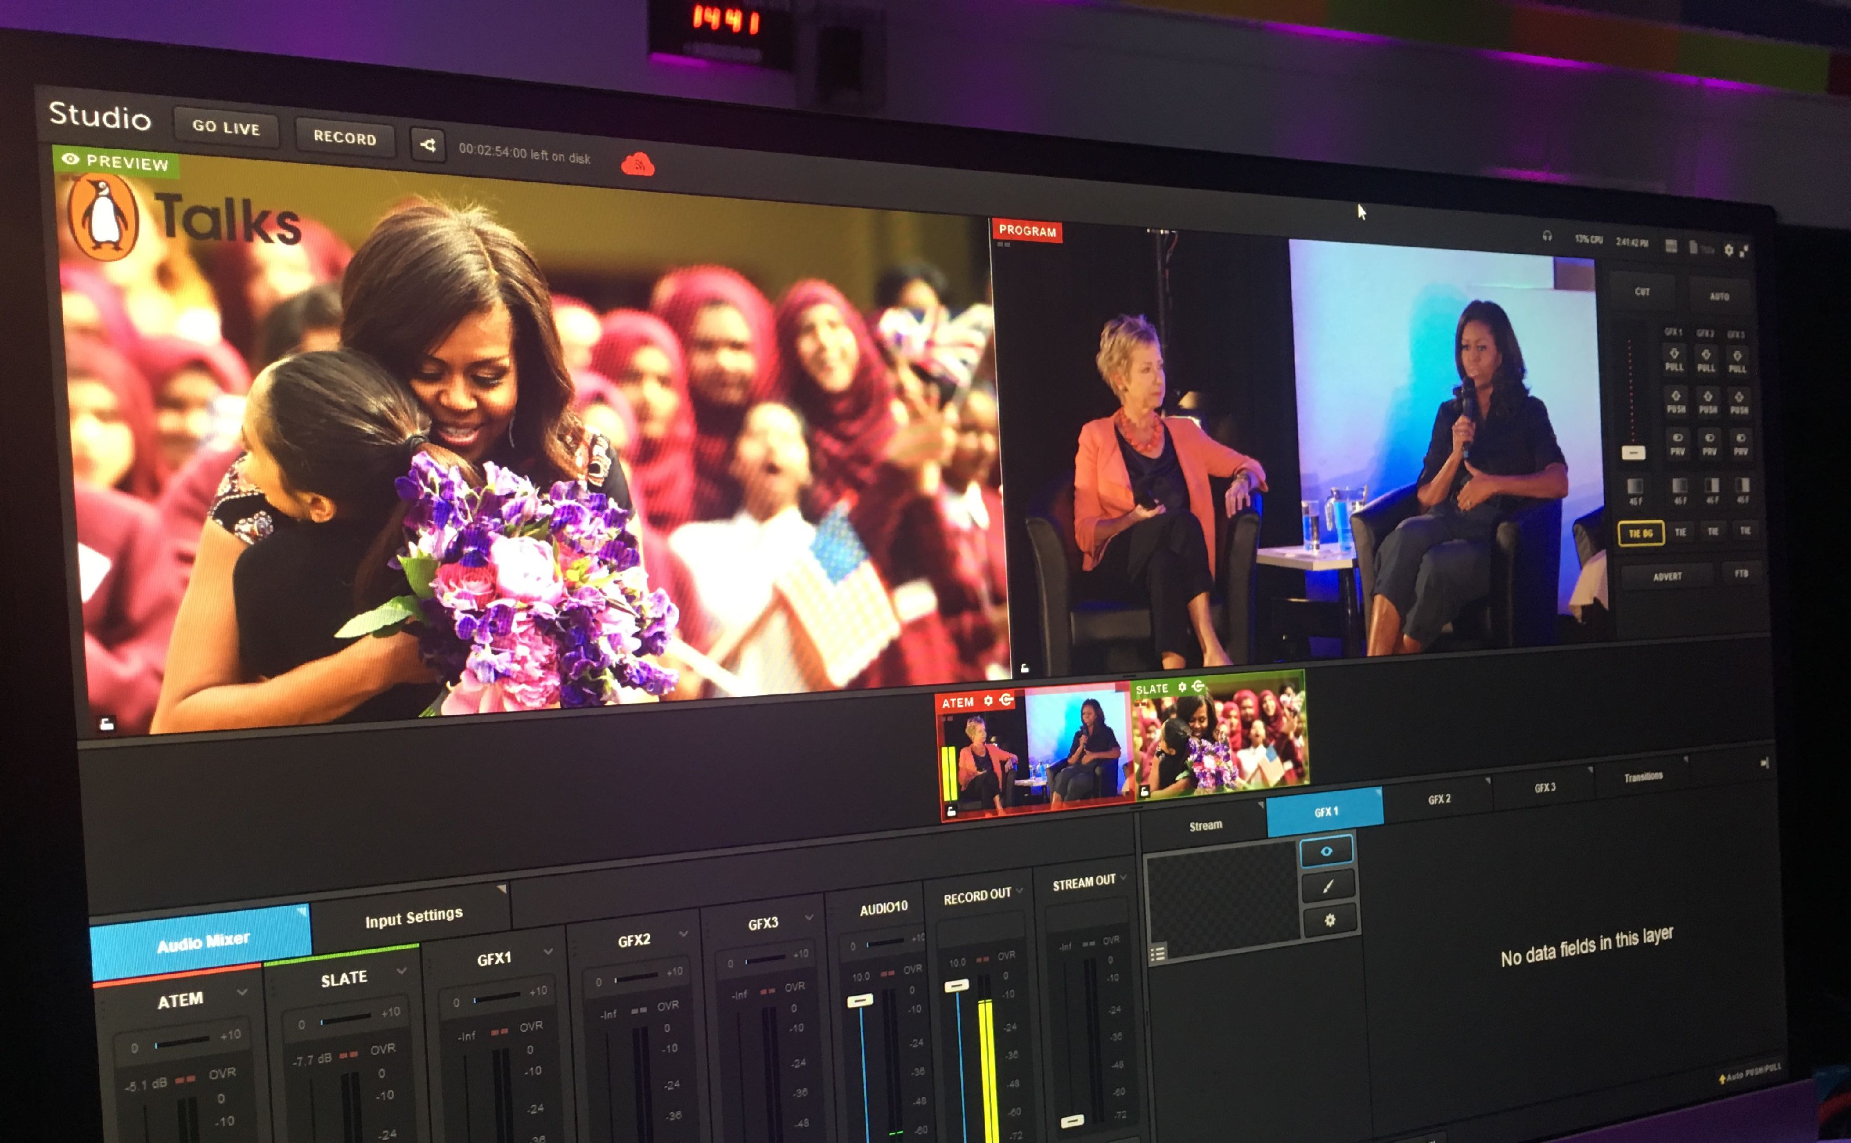
Freelance AV Technician
Michael
Lewis
Email Now
Penguin Books - Talks
Michelle Obama 2018
As video lead for our client Penguin Books, I had the privilege of working on set with Michelle Obama. With C3 Productions as the event producers, I took care of Michelle’s and Penguin’s content, projection and Facebook live streaming. The Talk’s series has been fantastic to work with, letting me be a fly on the wall to some of the most interesting authors of our modern day.
BACK
MORE PHOTOS

Slide 15
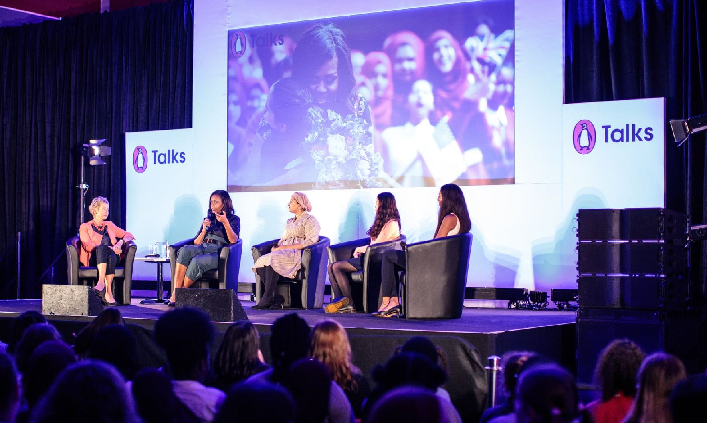
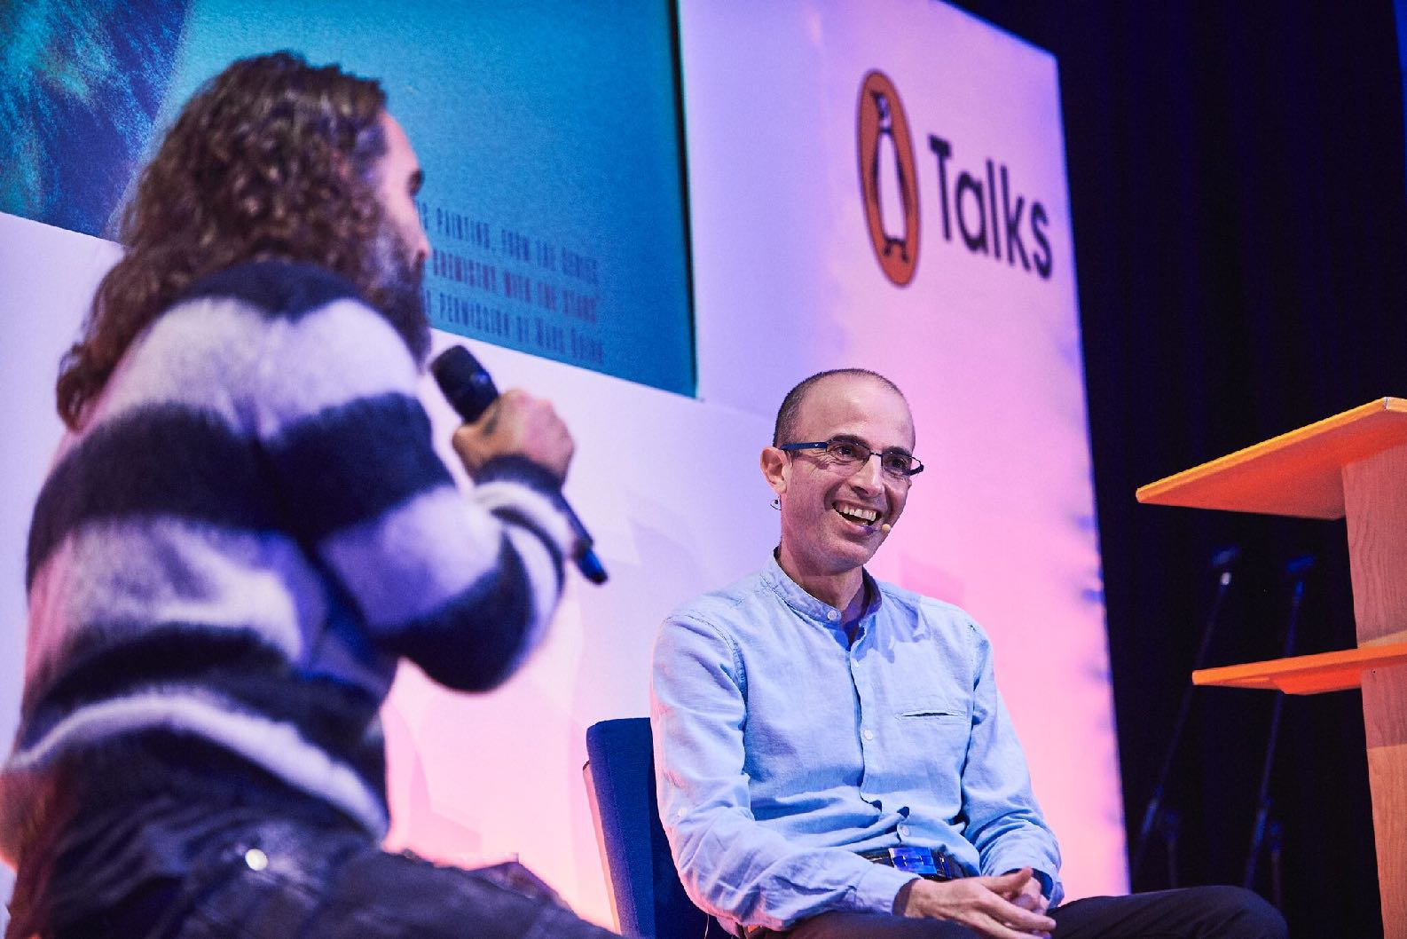
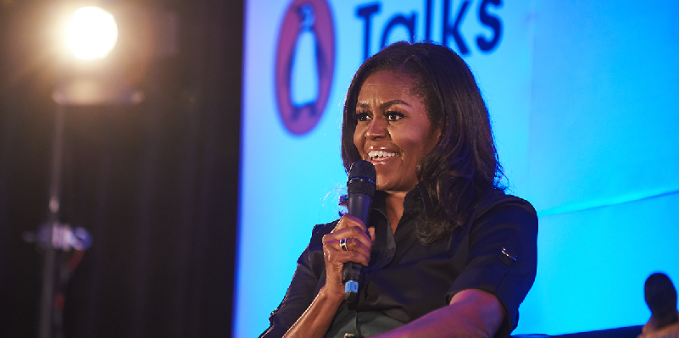

Freelance AV Technician
Michael
Lewis
Email Now
Penguin Talks
BACK

